Slide 1
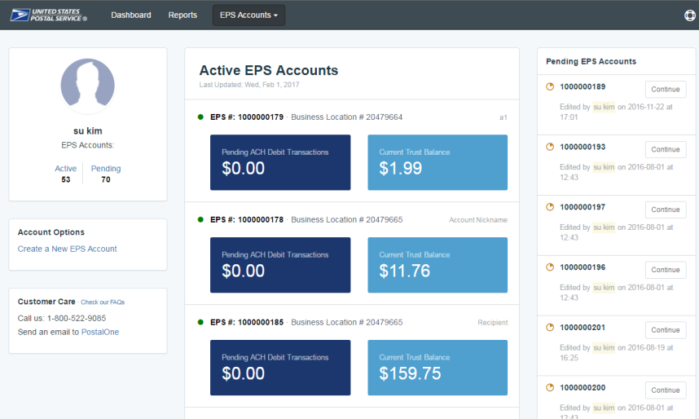
Payment Modernization
Project Description:
Payment Modernization is a cloud-based Enterprise Payment solution for USPS which allows commercial customers to securely pay for USPS products and services using a centralized application that they can access and manage online.
Accenture’s Role:
Development of Enterprise Payment application & lead solution integration
Develop Data Migration & Change Management Plans
Implementation and support of Amazon Web Services (AWS) environment
Application Support and Monitoring of the Production environment
Benefits to USPS:
Streamlined experience - payment hub for USPS products/services
Expanded payment options, attractive to new customers
Increase availability, capacity-on-demand with AWS solution
Elimination of manual, paper based processes
FY18 Milestones:
Release 3 (10/22/17): Support payment for mailings via PostalOne!.
Release 3.1 (11/9/17): Support updated Customer Registration interface to improve system performance
Release 3.2 (1/21/18): Support mobile check capture and the Accounting Data Mart (ADM)
Release 3.3 (5/13/18): ACH Debit Return logic updates, Online Permit Creation.
Release 3.4 (7/11/18): Support Package Platform, IV Data Subscription
Release 3.5 (9/23/18): Support PC Postage, negative balance, reporting enhancements.
FY19 Milestones/Plans:
Release 3.6 (Deployment Date: 1/13/19): Support Price Change, update ACH Debit Backup functionality and misc. enhancements
Release 3.7 (Target Deployment Date: March 2019): New Deferred Payment functionality and misc. enhancements
Release 4 (Target Deployment Date: Summer 2019): Support purchases for Commercial Postal Store products.
Future Opportunities:
Enhancements – additional products; additional payment method options
Business support & increased application support
At a Glance:
Initial Project Start Date: September 24, 2015
USPS Organization: Mail Entry & Payment Technology
Team Location: DC & St. Louis
Team Size: 13
Skills/Technologies: Oracle E-Billing, AWS, Java Spring, Agile, VersionOne, ALM, Oracle SQL
Project Lead(s): Denis Wane, Pete Gingrich
Delivery Order: 1BITYS-15-C-0039
Growth Platform: TGP
Accenture Project Type / Services:
Project Management
Organization Design
Systems Integration
Bus. Case Development
Production Support
Training / User Support
Management Consulting
Application Dev/Test
Infrastructure Hosting
Cloud Computing
Updated: 10/31/2018

